Slide 1



FPT Software
ANDROID TRAINING
LESSON 13
Version 0.1

Slide 2
Agenda
Gestures
2/11/2012
Android Insights - 3
<number>/18

Slide 3
Location in Android
  ¿What?
    Location-based services are technique to figure out where you are
  ¿How?
    Prerequisites
    Location Manager
    Location Listener
Israel Ferrer - @rallat – israel@bubiloop.com
Notes:
24/06/09

Slide 4
Prerequisites
Manifest Permissions
  GPS Location
    <uses-permission android:name="android.permission.ACCESS_FINE_LOCATION"/>
  Network Location
  <uses-permission android:name="android.permission.ACCESS_COARSE_LOCATION"/>
Israel Ferrer - @rallat – israel@bubiloop.com

Slide 5
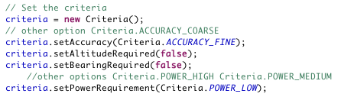
Location Manager
Location-Based Services (LBS) are handle using the LocationManager
Two Location providers in Android: GPS, Network
Define Criteria object to obtain the best provider
Israel Ferrer - @rallat – israel@bubiloop.com
Notes:
Imagine that your user has disable the GPS location and you use the gps as provider, you ll get a beauty force close so the best practices is use a criteria to get the best provider for every moment.

Slide 6


Location Manager
One we get the best provider is time to get location
  Get last know location
  Get the location changes
    Request Location Manager this updates
Israel Ferrer - @rallat – israel@bubiloop.com
Notes:
Google maps

Slide 7
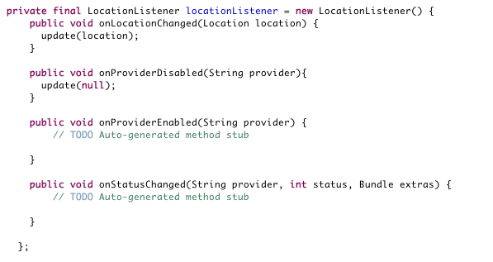
Location Listener
    Used for receiving notifications from the LocationManager when the location has changed
Israel Ferrer - @rallat – israel@bubiloop.com
Notes:
Location listener receive the notification from location manager on location change and trigger method that update de ui with new data that’s similar to swing.

Slide 8
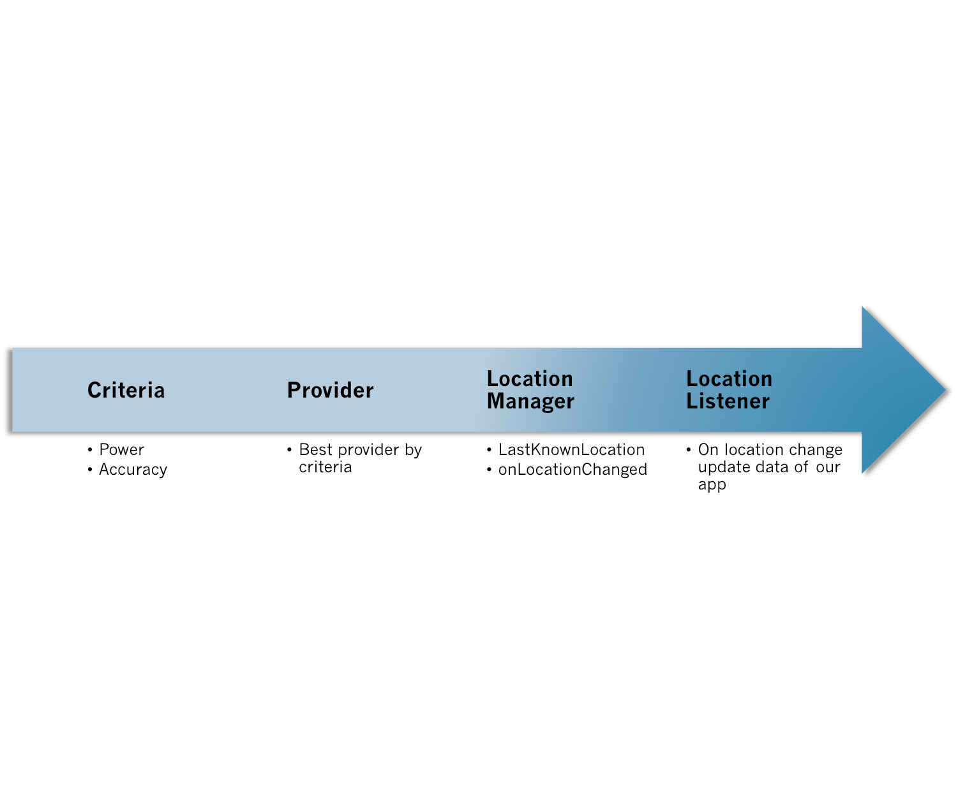
To Sum Up
Israel Ferrer - @rallat – israel@bubiloop.com

Slide 9
Google Maps in Android
MapActivity: Base class with code to manage the boring necessities of any activity that displays a MapView
MapView: A View which displays a map (with data obtained from the Google Maps service).
MapController: A utility class to manage panning and zooming of a map.
MyLocationOverlay: An Overlay for drawing the user's current location (and accuracy) on the map, and/or a compass-rose inset.
Israel Ferrer - @rallat – israel@bubiloop.com
Notes:
Las clases más importantes de la libreria son estas.
MapView(ItemizedOverlay(Item(GeoPoint))))

Slide 10
Google Maps in Android
  ¿What?
    We can show custom markers with info at someplace in a map
  ¿How?
    Prerequisites
    Show the map using MapView
    Create our custom marker class
    MapActivity:
      Add marker to our located overlays
      Add this located overlays to our MapView
Israel Ferrer - @rallat – israel@bubiloop.com

Slide 11
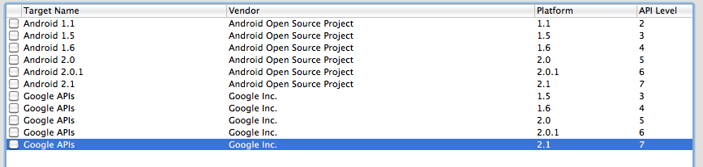
Prerequisites
Create an Android project with Google APIs support
Israel Ferrer - @rallat – israel@bubiloop.com

Slide 12
Prerequisites
Manifest Permissions:
  Add permission to use Google Maps external library
  <uses-library android:name="com.google.android.maps" />
  Add permission to use Internet
  <uses-permission android:name="android.permission.INTERNET" />
Google Maps API key for mobile:
  http://tinyurl.com/androidkeyapi
Israel Ferrer - @rallat – israel@bubiloop.com

Slide 13
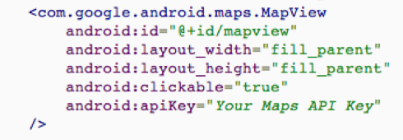
MapView
XML Definition MapView
Israel Ferrer - @rallat – israel@bubiloop.com

Slide 14
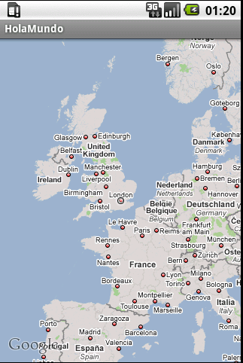
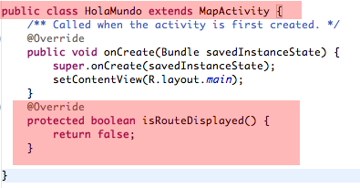
MapActivity
Create MapActivity to show the MapView
Israel Ferrer - @rallat – israel@bubiloop.com

Slide 15
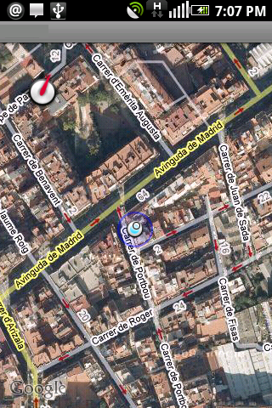

MyLocationOverlay
This object create an overlay that shows your location.
Notes:
24/06/09
24/06/09

Slide 16
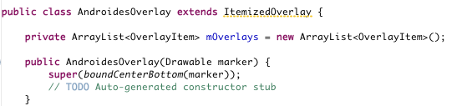
Custom Marker
Object that extends ItemizedOverlay
Object is initialize with a Drawable our custom marker
Notes:
24/06/09

Slide 17
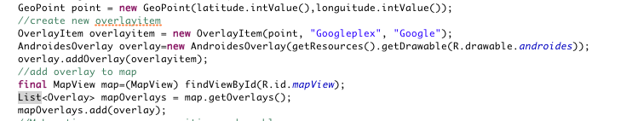
Custom Marker
Populate our custom marker ItemizedOverlay with OverlayItems
Finally, add our custom marker Overlay to MapView Overlays
Notes:
24/06/09

Slide 18
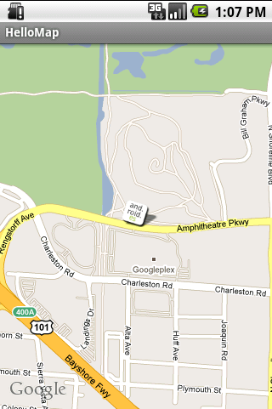
Hello Map!
Israel Ferrer - @rallat – israel@bubiloop.com

Slide 19
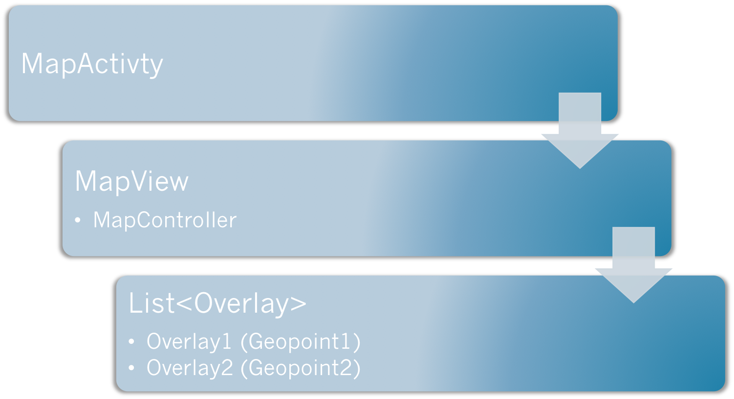
To Sum Up
Israel Ferrer - @rallat – israel@bubiloop.com

Slide 20
Homework
Merge 2 examples: GPS and GoogleMap to update current user’s position when user move -> should use Dashbroad project

Slide 21
Thank you!

